Slide 1
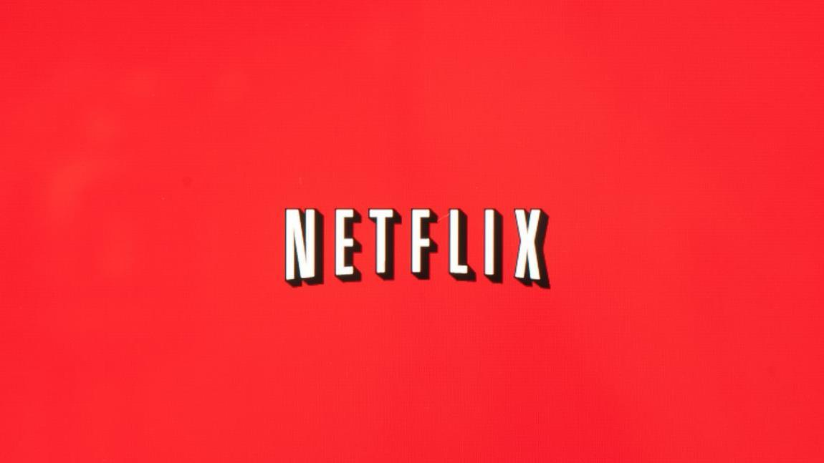
Netflix Movies and TV Shows
Michael J Murray
Colorado State University Global
MIS581: Capstone
Dr. Kimberly Ford
November 7, 2021

Slide 2
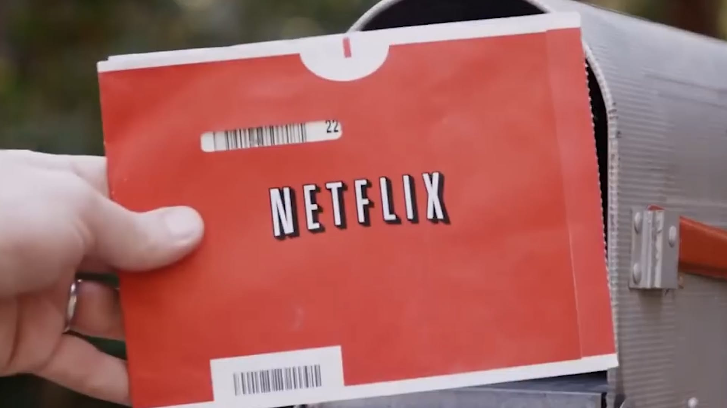
Company History
Notes:
Netflix is an entertainment company, headquartered in Los Gatos, California. Netflix offers monthly subscriptions to customers who in turn are able to stream unlimited movie and TV shows. The company started out as a rent by mail service for DVDs where fee structures were tied to how many movies were allowed out at one time. Customers could choose what movies they wanted online and they were mailed to them in red envelopes which included a postage paid envelope to mail the movie back once they were done. (Mahtani, 2021).

Slide 3

Objectives and Overview
OBJECTIVES
The objective of this research paper is to determine what type of content is preferred by Netflix’s customer base. Analyzing the data on current user ratings will determine where funding should be spent to add and create content that customers will like. Predictive analytics will be used to determine at what pace movies and tv shows are added and if that trend will continue through 2022.
OVERVIEW OF STUDY
User ratings were taken from a subset of all available content available on Netflix. The dataset contains the title, rating, rating level, rating description, release year, user rating score and user rating size. The dataset contains 497 unique shows available on Netflix and includes content ranging from G to R.

Slide 4

Data Usage
Notes:
Netflix generates a substantial amount of data on their viewers and utilizes that data to improve the platform by making better suggestions based upon algorithms setup consistent with how previous shows were viewed and rated by the viewer. These ratings are also used to determine what content to add in the future so that the company can maintain their current customer base in addition to adding more customers.
In a streaming market where competition is growing a rapid pace, generating and understanding the data coming in is important to stay ahead of the competition. Netflix’s model itself is easily copied; in simplest terms, offer tv shows and movies on demand for a nominal cost. The ability to cut costs by determining exactly what viewers are looking for, coupled with the ability to make meaningful suggestions of what to watch next is what sets Netflix apart from the competition.

Slide 5
Business Questions
Notes:
The company can use the dataset to determine any gaps in genres that may be missing from the streaming service. This will lead to a well-rounded library, which includes something for everyone in the family. The dataset can also be utilized to determine the genres that are rated the best by their viewers to determine what content to add to their streaming service. Based upon past ratings it will be determined what the likelihood of the user rating will be. Within the rating level it will be determined if any keywords trigger a better rating from the viewers
This knowledge will assist the company in making informed business decisions that will boost the profitability of the company. When creating new content, it could be determined if spending extra money to bring in certain actors would be beneficial based upon prior ratings of movies with the same actors. The data can also tell the story of what genres are enjoyed most by the viewers so the company can focus on adding and creating content that aligns with what their customers are looking for.

Slide 6
Hypothesis
H0: Rating has no effect on the way a user rates the show.
H1: Shows with a mature rating have a higher user rating.
Notes:
It is important to resist the temptation to find, build, and deploy resolutions without first understanding what the context is in which the problem exists (Nelson, 2018).

Slide 7
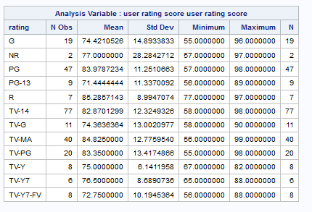
Statistical Analysis of Ratings vs User Score

Slide 8
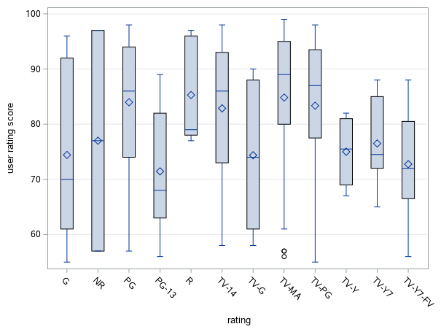
Box Plot of Rating by User rating score
Notes:
As can be seen in the box plot, Movies and TV shows have higher user ratings with TV shows having a few outliers with low ratings. This would cause the null hypothesis to be rejected and the alternate hypothesis to be accepted. It is with this data that a recommendation should be made to put an emphasis on mature rated content. There should not be an exclusive focus on mature content as the main goal is to provide content for people of all ages and background. However, there should be a slight emphasis on adding mature content.

Slide 9
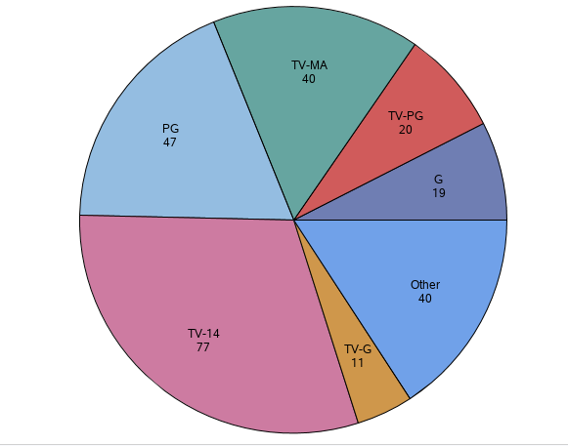
Pie Chart of Ratings Distributions
Notes:
The pie chart in shows that TV-14 shows make up a majority of the content on Netflix. While they are rated in the higher spectrum, there are other ratings that are rated higher by users that are underserved.

Slide 10
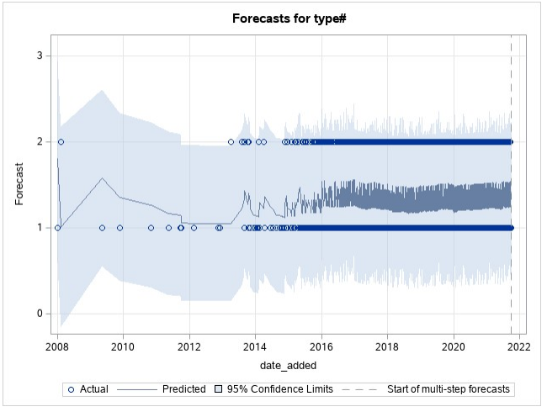
Notes:
The time series modeling that is being used is an Arima (3,1,1). The time series model shows that movies are being added at a more rapid pace than that tv shows. As can be seen by the time series chart, both Movies and TV shows are being added at a rapid pace. Movies are being added at a greater frequency and this is projected to be continued into 2022.

Slide 11
Ethical Concerns
Collecting and utilizing data to improve user experience is a necessity as product overload could be enough to cause many users to give up searching for what show to watch next purely out of frustration. Netflix utilizes data based upon customer viewer preferences to deliver a seamless experience to their users. Having over 15,000 titles on their streaming service provides a great selection but makes figuring out what to watch difficult at times.
The greater the time spent watching movies on Netflix decreases the likelihood of the user cancelling their service. Users can set up profiles that can filter out adult rated content as well as keep track of the shows you watch in addition to whether or not you enjoyed them, then recommend other titles that you might like. In order to remain profit, companies need to rely on data to make informed business decisions. Making original content or purchasing content that is not in line with what viewers preference could waste millions of dollars that would be difficult for Netflix to make up.
Notes:
As a society we value the privacy and the protection of our way of life. Most people would like to have at least some control over what information is available on them. They certainly do not want their personal information to be accessible to just anyone no matter how menial it may seem (Hoven et al, 2019).

Slide 12


Notes:
In conclusion, this dataset provides the ability to cut costs by determining exactly what viewers are looking for, coupled with the ability to make meaningful suggestions of what to watch next. These factors are what set Netflix apart from the competition. This knowledge will assist the company in making informed business decisions that will boost the profitability of the company.

Slide 13
References
Bansal, S. (2021, January 18). Netflix Movies and TV Shows. Retrieved from
https://www.kaggle.com/shivamb/netflix-shows/discussion/241645
Mahtani, S. M. (2021). Netflix, Inc. Salem Press Encyclopedia.
Nelson, G. S. (2018). The analytics lifecycle toolkit: A practical guide for an effective analytics
capability. Hoboken, NJ: John Wiley & Sons
Van Den Hoven, J., Blaauw, M., Pieters, W., & Warnier, M. (2019, October 30). Privacy and
Information Technology. Retrieved from https://plato.stanford.edu/entries/it-privacy/
Willden, C. (2017, June 02). Netflix Shows - Dataset by Chase Willden. Retrieved from
https://data.world/chasewillden/netflix-shows
Yahoo Finance. (2021, September 22). Netflix, Inc. (NFLX) Company Profile & Facts.

